Slide 1

BDAT 1004 – Data Programming
FINAL PROJECT

Slide 2
Meet the team (Group 2)
Joyson Domnic Gonsalves
Developer
Oluwakorede Balogun
Project Manager
Laxman Rokaya
Business Analyst
Sulav Thapa
Data Analyst
Darpan Aryal
Data Analyst

Slide 3

Agenda
Project description
Data retrieval and storage
Data retrieval script execution
MongoDB Database Class File
Data Analysis Jupyter Notebook
Data Visualization

Slide 4
Project description
This project explores Spotify data to uncover patterns in song popularity, release dates, and genre trends. Through user-friendly charts, it visualizes insights into the factors influencing music popularity, offering a concise examination of the dynamics behind popular music.
To comply with the client’s requirements, we have developed the project with the following processes:
A Python script will fetch data from Spotify API and convert it to a CSV file.
The CSV file will then be stored on a remote cloud server from which it can be accessed from anywhere.
The script collects data from Spotify API and properly arranges it into tabular format while removing unnecessary data.
With the help of Jupyter Notebook and Matplotlib, a Python library we are able to do visualization which includes graphs and charts.

Slide 5
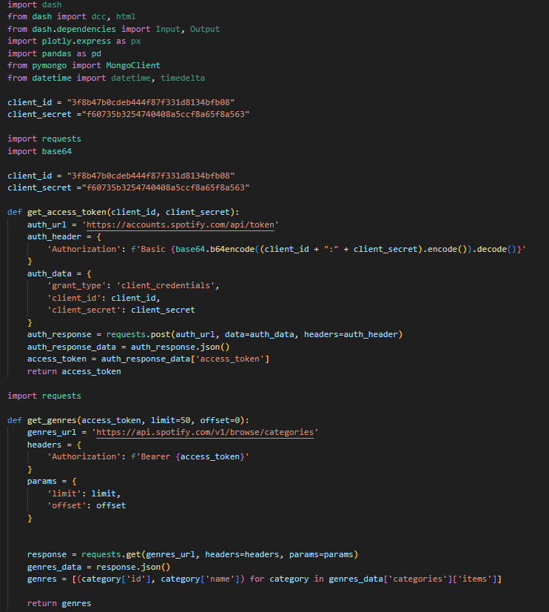
Data Retrieval and Exploration
Spotify API Integration
1.Client credentials authentication using a client ID and secret.
2.Retrieving access tokens for API requests.
Genre Exploration
1.Fetching available genres using Spotify API.
2.Creating a DataFrame with song details for each genre (Top 50 tracks per genre).

Slide 6
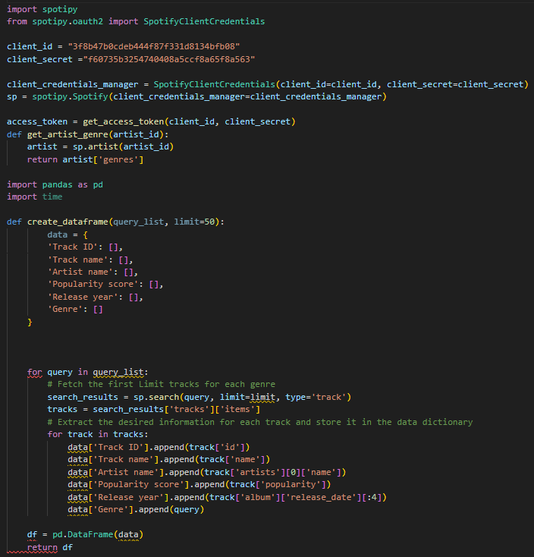
Popularity Analysis
Popularity Score Visualization
Calculating and visualizing average popularity scores for different genres.
Identifying the top 10 genres based on popularity.
Filtering and Cleaning
Removing duplicates and filtering out tracks with popularity scores below a threshold.

Slide 7
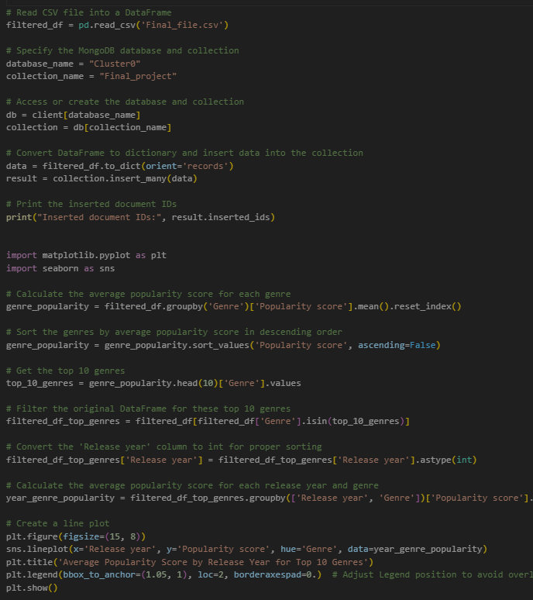
Data Storage and MongoDB Integration
MongoDB Integration
Establishing a connection to MongoDB Atlas.
Storing cleaned and filtered data in a MongoDB collection named "Final_project."
Data Visualization
Creating visualizations:
Average Popularity Score by Release Year for Top 10 Genres.
Heatmap of Popularity Scores by Release Year and Genre.

Slide 8
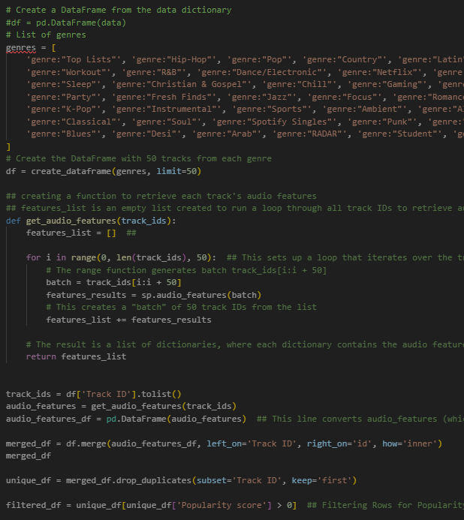
Fetching data to mongodb
The analyze.ipynb jupyter notebook file can be executed on demand.
The notebook retrieves data from the mongodb database, and creates visualizations to answer the client’s answers.

Slide 9
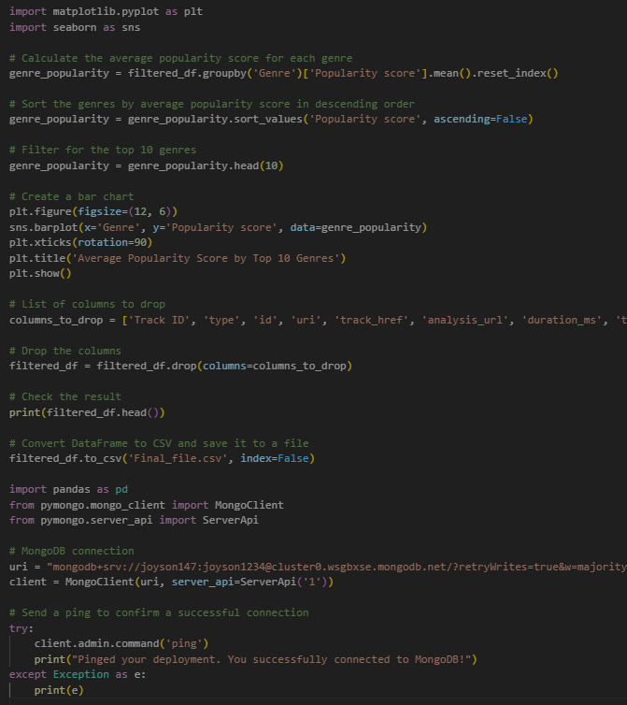
Feature Correlation Analysis
Feature Correlation
Subset analysis on the top 10 popular genres.
Investigating correlations between popularity score and acousticness, danceability, energy, etc.
Visualizing Correlations
Heatmap representation of feature correlations for insightful analysis.
Providing a comprehensive understanding of how different musical features correlate with overall popularity.

Slide 10
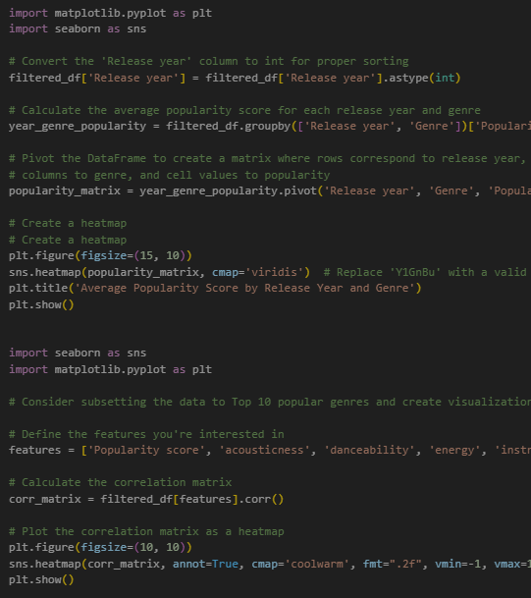
visualization
Data charts and graph like Bar Graph, Line Graph, Heatmap, and Correlation Heatmap are utilized.
With the help of graphs and charts, it makes easier to understand large amount of data.

Slide 11

Data Visualization

Slide 12
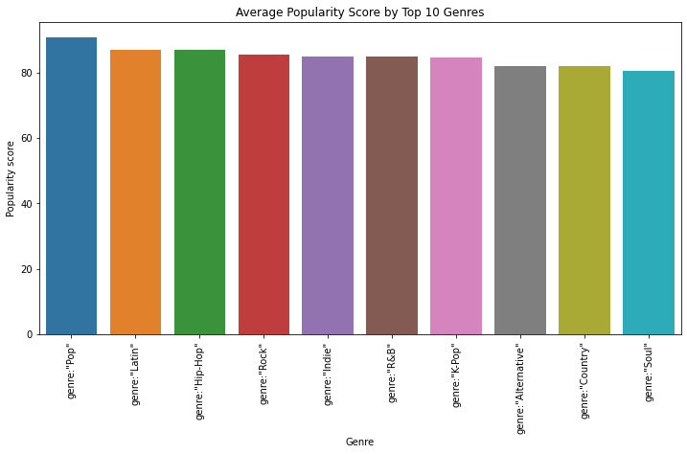
Bar Graph
Average Popularity Score by Top 10 Genres

Slide 13
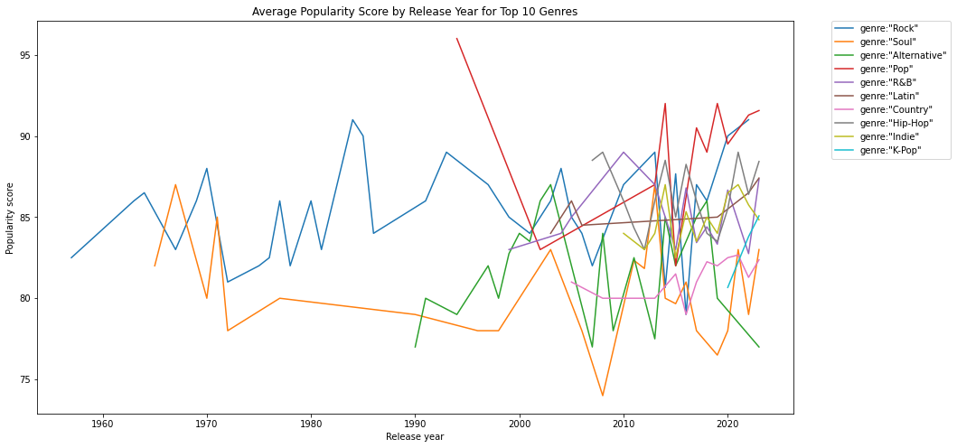
Line Graph
Average Popularity Score by Release Year for Top 10 Genres

Slide 14
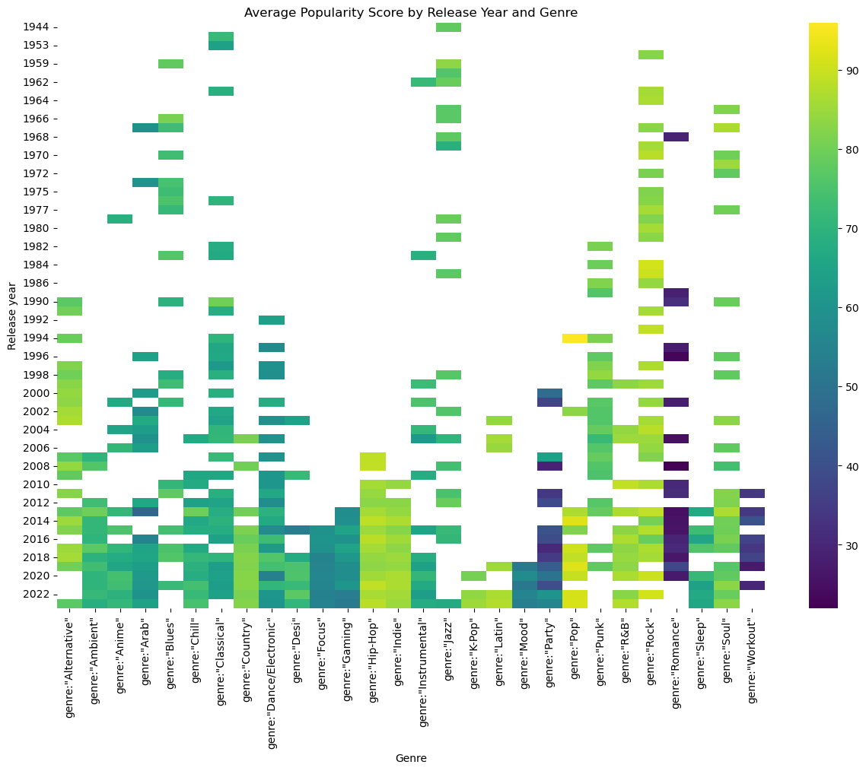
Heatmap
Average popularity score by release year and genre Heatmap

Slide 15
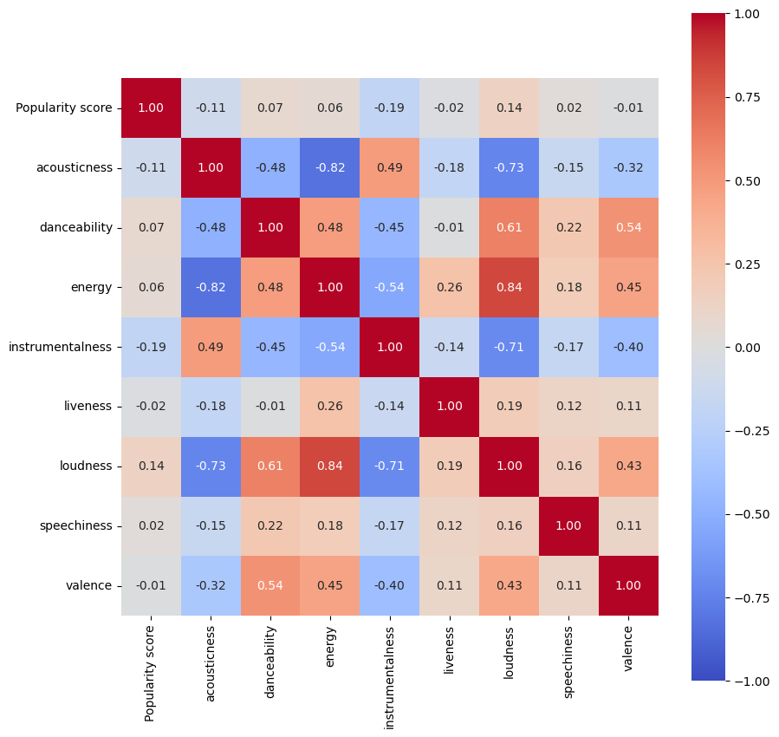
Heatmap showing correlation
Heatmap showing the correlation between various parameters

Slide 16

SUMMARY
Average Popularity Over Time and Genres:
Charts average popularity scores from 1944 to 2022 for genres like Pop, R&B, Jazz, and Rock.
Y-axis represents popularity scores, and X-axis shows genres and release years.
Highlights trends and changes in popularity across different music genres.
Correlation Treemap for Music Attributes:
Visualizes correlations between music attributes (acousticness, danceability, energy, etc.).
Matrix of numbers reveals relationships between attributes.
Enables understanding of interplay and clusters within the dataset.
Popularity Trends of Music Genres:
Depicts popularity trends for genres like Rock, Soul, Pop, Hip-Hop, etc.
Y-axis represents popularity scores, and X-axis shows different genres.

Slide 17
THANK YOU

